Slide 1
Different art styles for our game
Ionut Ciobanu

Slide 2
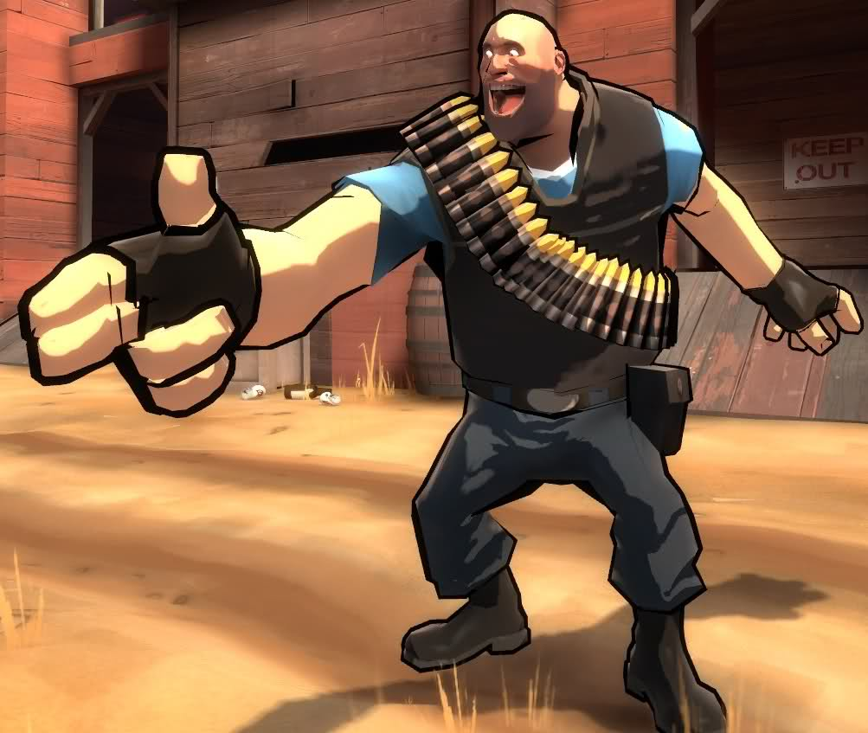
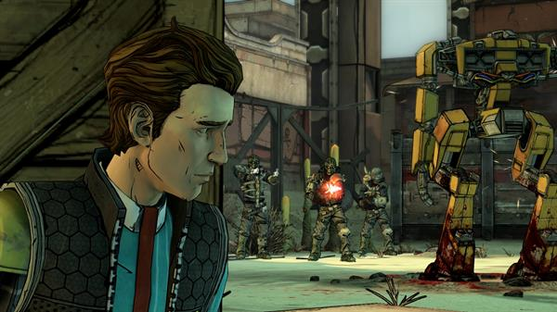
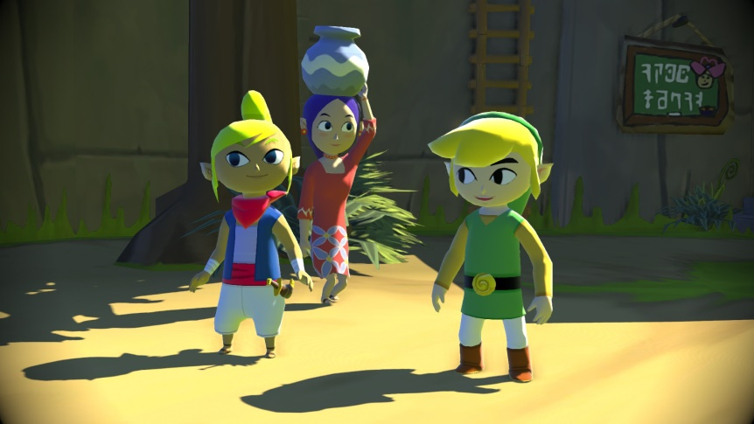
Cel-Shading
Cel-Shading is when the texture of an object is made to look like it’s been taken out of a comic book or a hand drawn image using flat colours (giving the impression it’s been hand drawn).

Slide 3
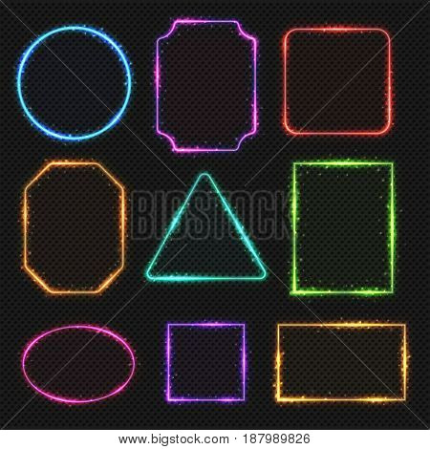
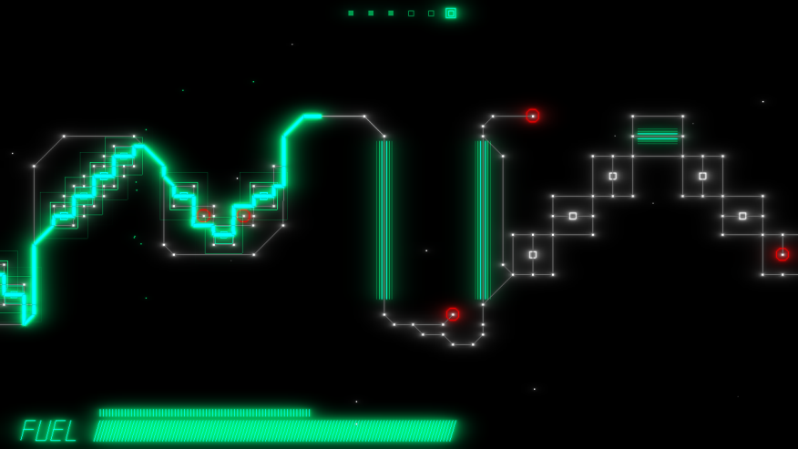
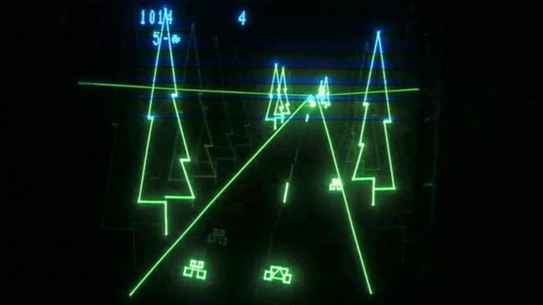
Vector Graphics
Shiny colourful lines, geometrical shapes to represent game objects.

Slide 4
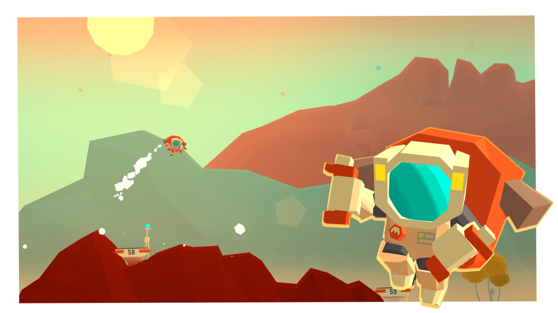
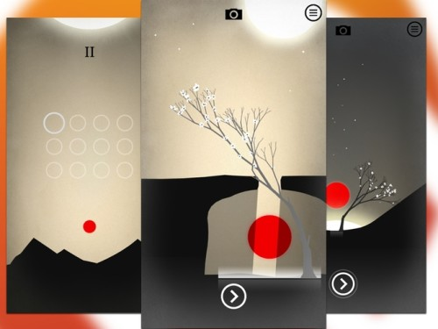
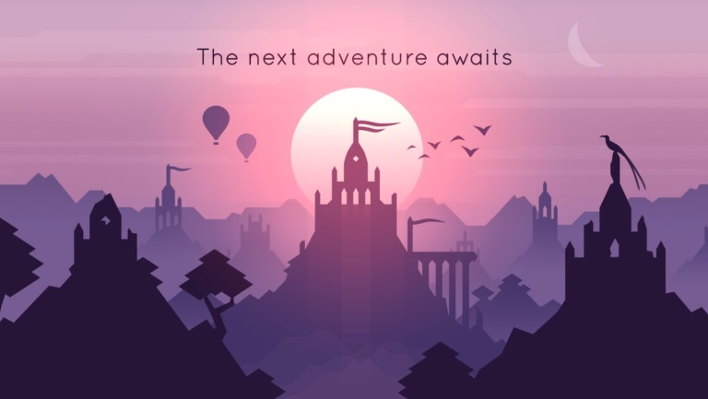
Material Design
Characterized by “deliberate colour choices, edge-to-edge imagery, large-scale typography, and intentional white space” for a bold, graphic look according to Google.

Slide 5
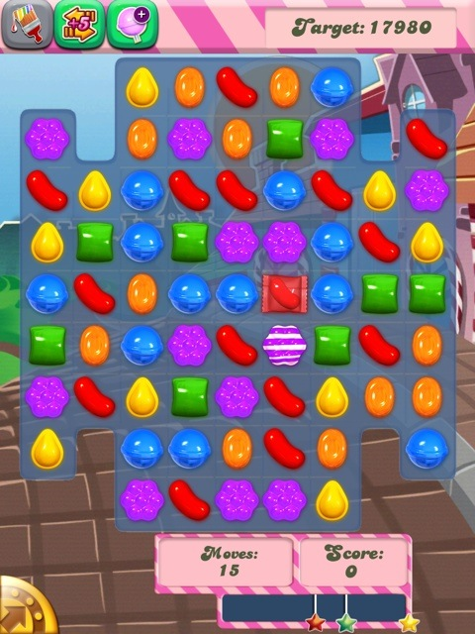
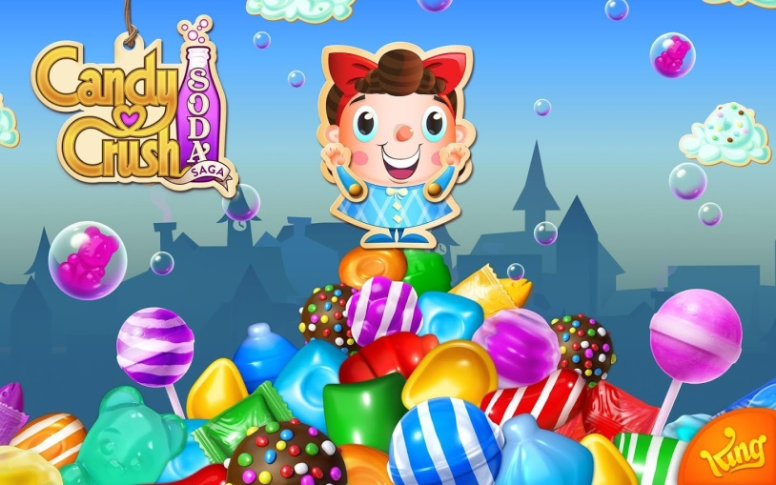
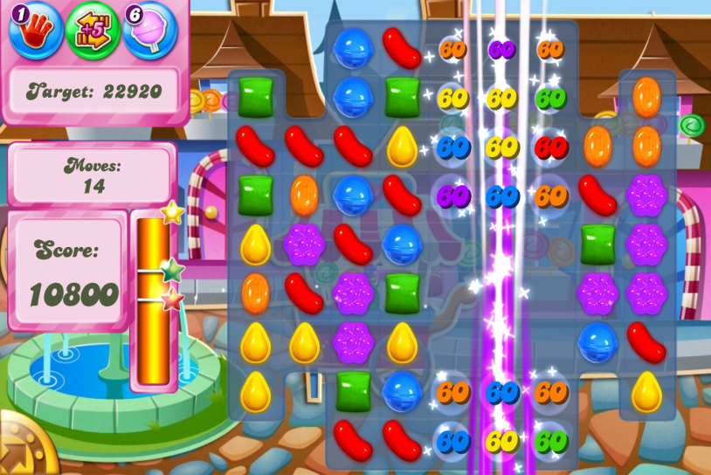
Stylized, modern, Candy Crush like
An art style similar to Candy Crush’s art style, as it’s pretty similar to our game.

